Slide 1

Promotion and Tenure Seminar
2024

Slide 2

Nahid J. Rianon, MD
Associate Dean of Faculty Affairs
Professor and Memorial Hermann Chair
Joan and Stanford Alexander Division of Geriatric and Palliative Medicine
Department of Internal Medicine
Johnson George, MBA
Assistant Dean, Office of Administration and Faculty Affairs
Kevin A. Morano, PhD
Senior Vice President, Academic and Faculty Affairs
Senior Associate Dean for Faculty Affairs

Slide 3
Office of Administration and Faculty Affairs
Tina Clark
Executive Services Administrator
713-500-5103
Tasamania.D.Clark@uth.tmc.edu

Slide 4
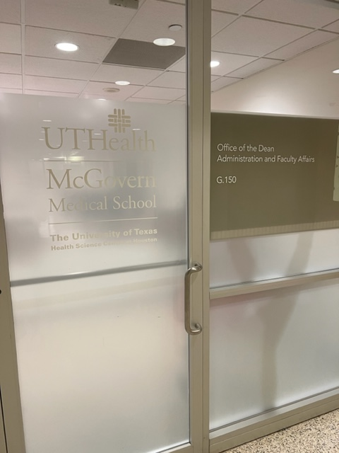
The Office of Administration and Faculty Affairs - MSB G.150

Slide 5

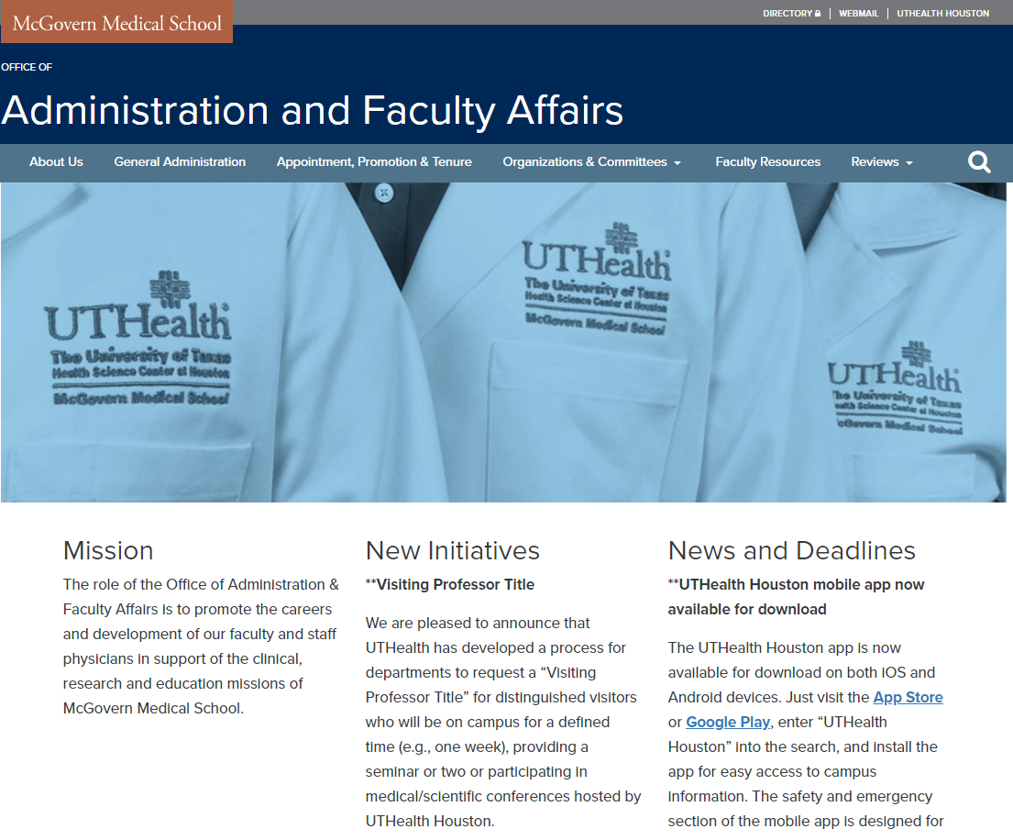
https://med.uth.edu/administration/

Slide 6
Academic Tracks
Clinical, non-tenure track
Research, non-tenure track
Instructional, non-tenure track
Tenure track
    Clinician/Educator pathway
    Scientist/Educator pathway

Slide 7
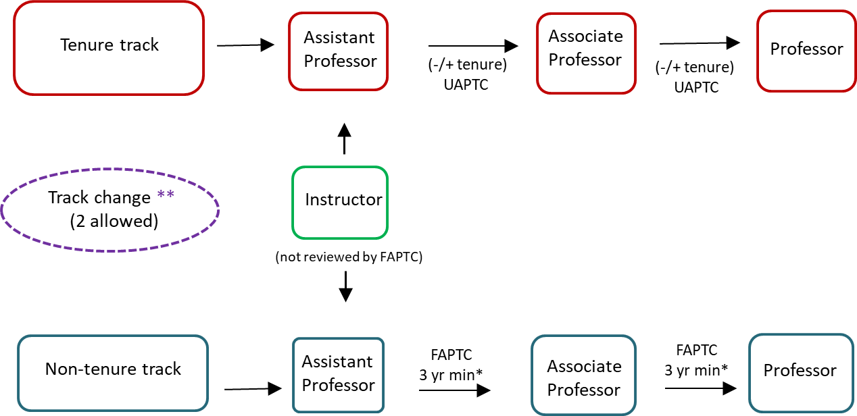
Ranks, Tracks, and Pathways to Promotion and/or Tenure
*Minimum of 3 years in rank is required for promotion (HOOP); however, less than
5 years at time of submission is considered accelerated.
** Requested by faculty member and approved by Dept. Chair and Dean, effective 9/1.
Time off the tenure track does not count toward the 9-year tenure probationary period.
(tenure must be awarded before 9th year)

Slide 8
Comparison of Promotion on the
Tenure and Non-Tenure Tracks
Non-Tenure Track
“Department letters” (3 Internal & 6 External)
Must show a local/regional reputation for Associate professor, need not be fully independent work, national/international reputation expected at the full professor level
May have a narrower contribution to university (e.g., to McGovern or limited to the USA only)
Tenure Track
“Department letters” (3 Internal & 6 External)
“Dean’s letters”
Must show a national or international reputation for focused scholarship; must be original, directed work
Requires a broader contribution to the university (e.g., in more areas of endeavor)

Slide 9

Expectations
Planning for Promotion and Tenure

Slide 10
For clinical track
Qualifying for Promotion:“Clinical Activities”
Clinical service is highly valued for its role in education and discovery
Volume, quality, and impact
Quality improvement projects - improving patient outcomes
Developing or expanding clinical programs
Innovation in techniques, instrumentation, procedures
Leadership in the clinical setting, e.g., medical director

Slide 11
Qualifying for Promotion:“Scholarly Activities”
Evidence of scholarly activity can be in many forms, e.g., peer-reviewed publications, invited articles, awards and honors, participation on grants, patents issued/licensed, etc.
Presentations, case studies, speaking invitations (grand rounds, podium presentation on scholarly products, e.g., abstracts/preliminary data, poster presentations and media [TV, radio, online news, letters, blogs, etc.] interviews to answer questions that relate to the field of expertise).
In general, the scholarly activity must be documentable and must demonstrate some impact on the candidate’s field.
Disseminated/adopted QI programs (change in policy or process). Please add QI charter number when documenting QI on CV.

Slide 12
Qualifying for Promotion:“Teaching Activities”
Many types of teaching/educational activities
  Didactic, classroom teaching
  PBL/TBL
  One-on-one mentoring/training of undergraduates, graduate students (MS/PhD), medical students, postdocs, residents, fellows
  Bedside teaching (rounds) as well as workshops, M&M discussions
Teaching effectiveness, evaluation and assessment should be included in Chair’s letter of nomination
Patient/community outreach and education
Leadership in educational activities (PD, APD)

Slide 13
Qualifying for Promotion:“Service/Admin Activities”
Administrative activity is important to the institution, but it is rarely by itself the basis for promotion. Expected of all faculty at some level.
Committee work: division, department, school, university, hospital, society
Grant/guideline/paper reviewing
Leadership/admin examples: division director, vice chair, etc.
Leadership roles important for promotion to senior ranks (can be in professional societies: local/national/international)

Slide 14
NTC Promotion Criteria
Four Domains of Achievement
Clinical/Patient Care
Research/Scholarship
Education
Service/Administration
Activity in any domain that only meets basic employment expectations will be described as Acceptable and will not contribute toward consideration for promotion.
Performance above and beyond this level will be described as Commendable and will count toward promotion.
A second level of extraordinarily high performance will be described as Exceptional.
Quantitatively, these levels of achievement will be given point values of 0, 1 and 2, respectively.

Slide 15
NTC Promotion Criteria
For promotion to Associate Professor
1. Exceptional (2) in at least one domain.
2. At least a 1 in clinical.
    3. Total of 4 points.
For promotion to Professor
1. Exceptional (2) in at least two domains.
2. At least a 1 in clinical.
    3. Total of 5 points.
Chair’s letter and faculty narrative will build the case for proposed achievement levels and areas of focus

Slide 16
NTC Promotion Criteria
Example A: An innovative clinician with high clinical productivity and quality, significant committee service and activity in resident education with little to no published research seeking promotion to Associate Professor might claim Clinical: 2, Service: 1, Education: 1.
  Contribution to quality improvement related to patient outcomes (please keep the QI project numbers for documentation)
  Founder of a new clinic or service
  Leadership in expanding clinical services
Example B: A strong clinician with moderate clinical productivity and quality, multi-year appointment as Medical Director*, and several published research papers or quality project reports seeking promotion to Associate Professor might claim Clinical: 1, Service: 2, Research: 1.
Example C: Clinician with expected productivity, routine bedside teaching, has a K award or R01 or more than one R03 level grants (though may not be from NIH), with multiple publications, also with some McGovern and department level services, seeking promotion from assistant to Associate might claim Clinical:1, Education: 0, Research 2, Service 1.

Slide 17
NTC Promotion Criteria
Example D: An innovative clinician with high clinical productivity and quality, bedside supervision of multiple trainees and additional didactic teaching, multi-year appointment as Residency Director, several case studies and one or two peer-reviewed publications and a strong record of hospital committee service, seeking promotion to Professor might claim Clinical: 2, Education: 2, Research: 1, Service: 1.
Example E: A strong clinician with moderate clinical productivity and quality, little to no exposure to trainees, no publications and service on several committees in the last five years would be scored Clinical: 1, Education: 0, Research: 0, Service: 1, and would not yet be competitive for promotion. (This last case may also represent a faculty better suited to move to a Staff Physician appointment).
Example F: A clinician with standard clinical, education, some leadership in service with research activities or hospital committees with previous K and a current R01 may think about switching to the tenure track if they project growth in the clinical research pathway where they will be working on more future grants.
  In this case, think about all requirements that come with tenure track

Slide 18
Qualifying for Promotion:“Peer Esteem”
Reflects regional, national, international reputation
Clinical referrals, invited seminars/talks/meeting presentations
Grant review, journal review, invited reviews and book chapters
Overlaps with scholarship
Takes time and effort

Slide 19
Strategies for Getting Known Outside Your Institution
** Publish and present your work**
Join professional societies, go to meetings
Correspond with people whose work interests you
Agree to review grants, journal articles
Speak to the media, local and national organizations
Join large (national) collaborative research studies

Slide 20
II. Readiness for Promotion
Purpose of the Annual Faculty Review
  determine if the candidate is on track for promotion
  give guidance and plan for the upcoming year.
The Department (Internal) Review Committee
  reviews the candidate’s credentials with CV
  advises the Department Chair regarding the candidate’s promotion.
OAFA can review a candidate’s CV (in the UT format) in advance.
~IF IT IS NOT IN THE CV, IT DIDN’T HAPPEN~
Associate Dean, Nahid Rianon and Assistant Dean, Johnson George, will hold a 30-minute consultation session (Individual Promotion Plan/IPP) upon request with a current CV in the UT format

Slide 21
The Parts of Your Promotion Package
The Chair’s letter of nomination
CV in UT format
Promotion Narrative (required – maximum 6 pages). Only NTC should be scored
Internal letters of support (3) from colleagues within UTHealth but outside your department
List of 6 external references outside UTHealth* (“Department letters”)
Tenure track only: Faculty Affairs obtains references and letters from additional colleagues (“Dean’s letters”), who are nominated by those on your external reference list

Slide 22
Rules for External Letters
For all candidates
  At least 3 of the 6 external references submitted by the department should be from individuals outside of Houston who did not have personal contact with the candidate during training. External letters must be from various institutions outside of UTHealth.
  Avoid more than 2 letters from the same institution
Tenure track: national/international peer esteem
Non-tenure track: regional/state peer esteem
External referees should be peers who know the candidate through professional accomplishments and not from a personal relationship

Slide 23
Time Table
May 1 to August 31 – Department (Internal) Review Committee reviews recommendations
September 1 - Proposals due to the Dean, c/o OAFA
March/April - Health Science Center - University Appointments, Promotions and Tenure Committee meets
May/June - Health Science Center report due in Austin
August - Board of Regents meet (re: tenure actions)
September 1 - Promotion and/or Tenure becomes effective

Slide 24

Role and Philosophy of the FAPTC
  Advisory to the Dean
  “Gatekeepers”
  Quality of the faculty
  Reputation and future
  of the institution

Slide 25
Review Process by the FAPTC
For promotion to Associate Professor:
  Primary and secondary FAPTC reviewers
  assigned
  Reviewers present dossier at FAPTC meeting with recommendations
  FAPTC discusses and votes on recommendation,
  which is forwarded to the Dean

Slide 26
Review Process by the FAPTC
For promotion to Professor:
Ad hoc committee of 3 professors (FAPTC member as Chair and 2 MMS Professors)
Ad hoc committee reviews the dossier and prepares a report to FAPTC
The ad hoc committee chair presents the report at FAPTC meeting with recommendation
After discussion, the FAPTC votes on recommendation, which is forwarded to the Dean.

Slide 27
Dean’s Actions
Dean reviews the FAPTC recommendations and decides to endorse or not endorse them
The Dean notifies the candidate’s Department Chair of his decision
The Department Chair notifies the candidate

Slide 28
UTHealth Actions
The endorsed tenure track dossiers are forwarded to the SVP/Office of Academic and Faculty Affairs, and then President for the University Appointments, Promotions and Tenure Committee (UAPTC).
The outcome of the UAPTC action is conveyed to the Dean, who notifies the candidate via the Department Chair.

Slide 29
Take Away Messages…
Seek Help! OAFA, Chair, Vice Chairs/Development, Senior Colleagues…
Know what is expected of you
Actively guide your career path
  Assess your readiness for promotion
  Make a timeline
  Decide how best to direct your efforts in the time you have
  Revisit your plan and make mid-course corrections as needed
Document your achievements carefully
  IF IT IS NOT IN THE CV, IT DIDN’T HAPPEN
Seek professional visibility
Be flexible!

Slide 30
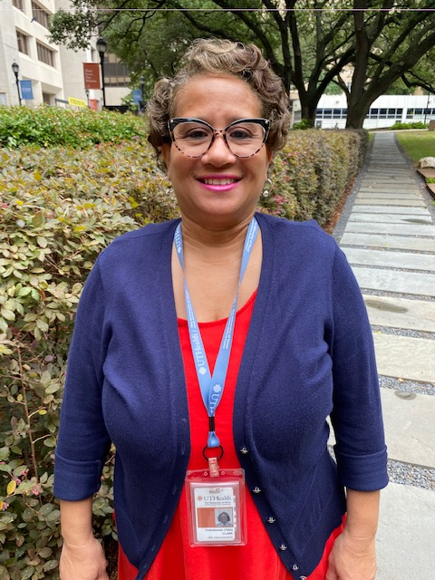
Need A Hand?
Office of Administration and Faculty Affairs
713-500-5103, MSB G150
tasamania.d.clark@uth.tmc.edu
  Consultation
  Information
  Assistance
Tina Clark

