Slide 1
SIC Salutation 2015 September 29, 2015

Slide 2
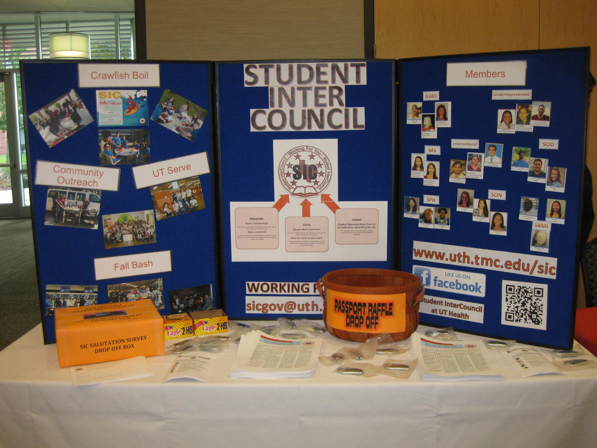

Slide 3
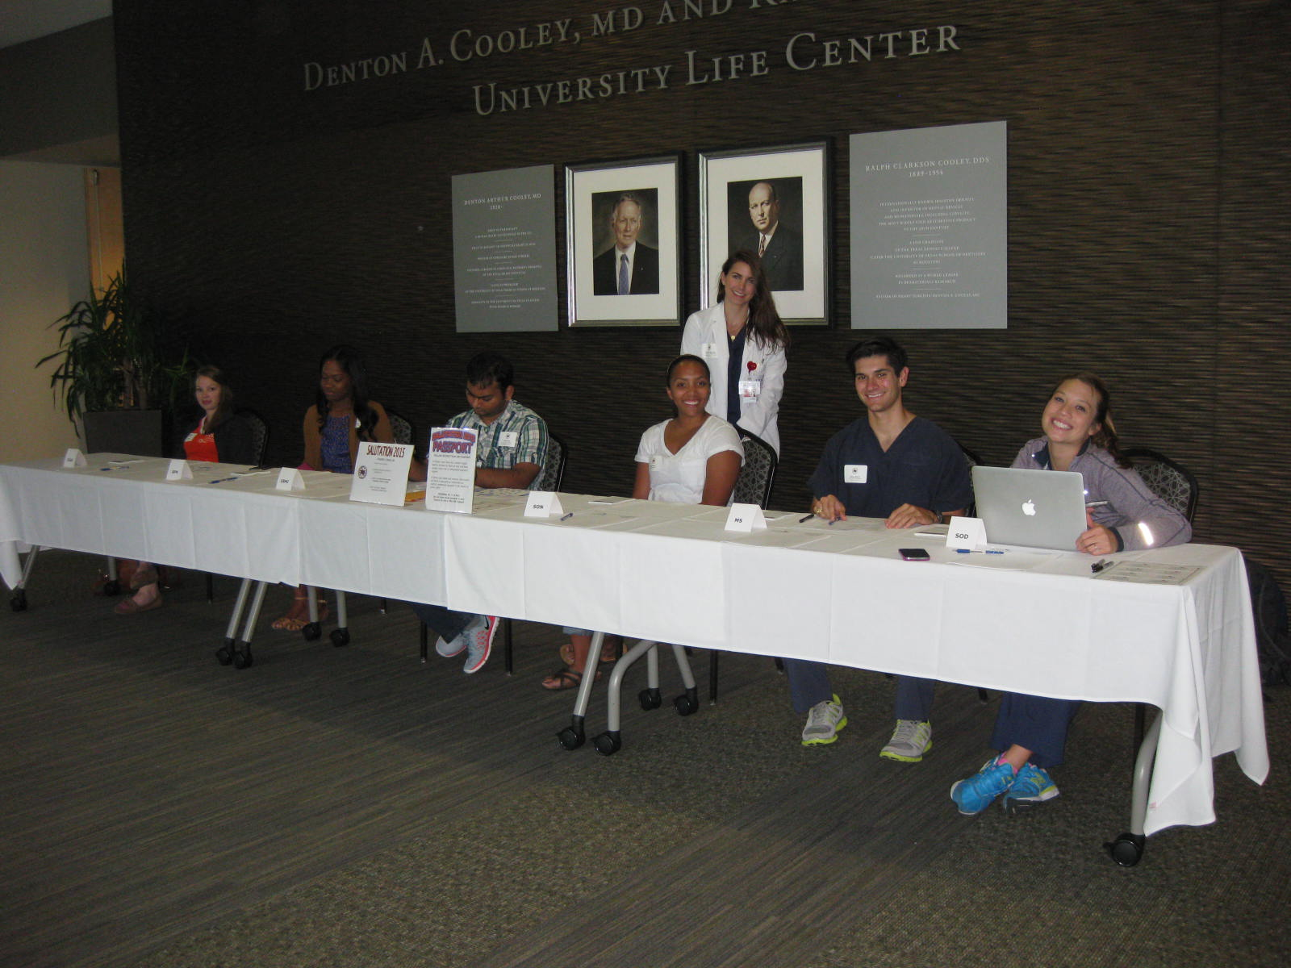
SIC Representatives ready to check in students at Salutation 2015!

Slide 4
Dr. Giuseppe Colasurdo, UTHealth President, giving welcome to students at Salutation 2015!

Slide 5
Medical School awarded the SIC Volunteer Service Award for 2015. Accepting award is Dr. Barbara Stoll, Dean, Medical School and Dr. Colasurdo, UTHealth President and prior Dean to the Medical School.

Slide 6
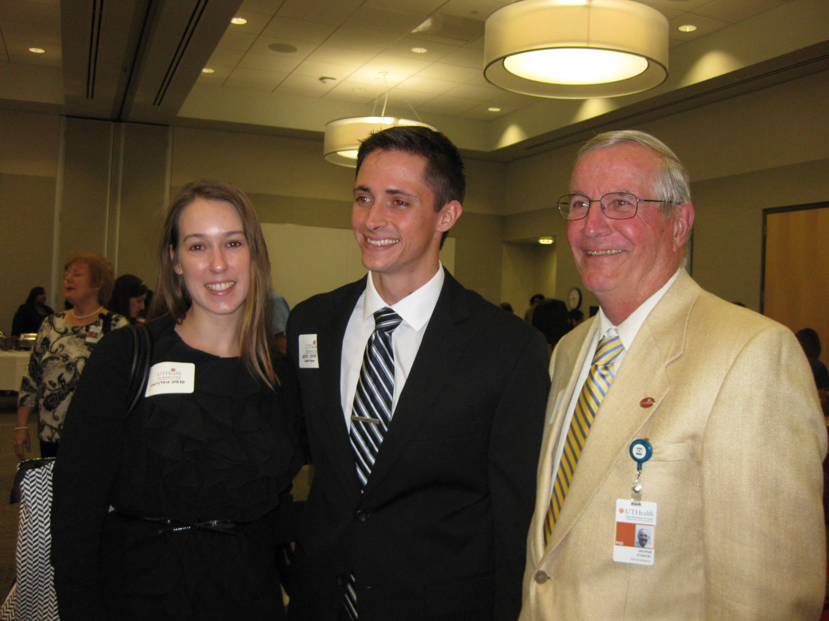
UT System Student Regent, Justin Drake with wife, Christine and Dr. George Stancel, UTHealth EVP for Academic and Research Affairs

Slide 7
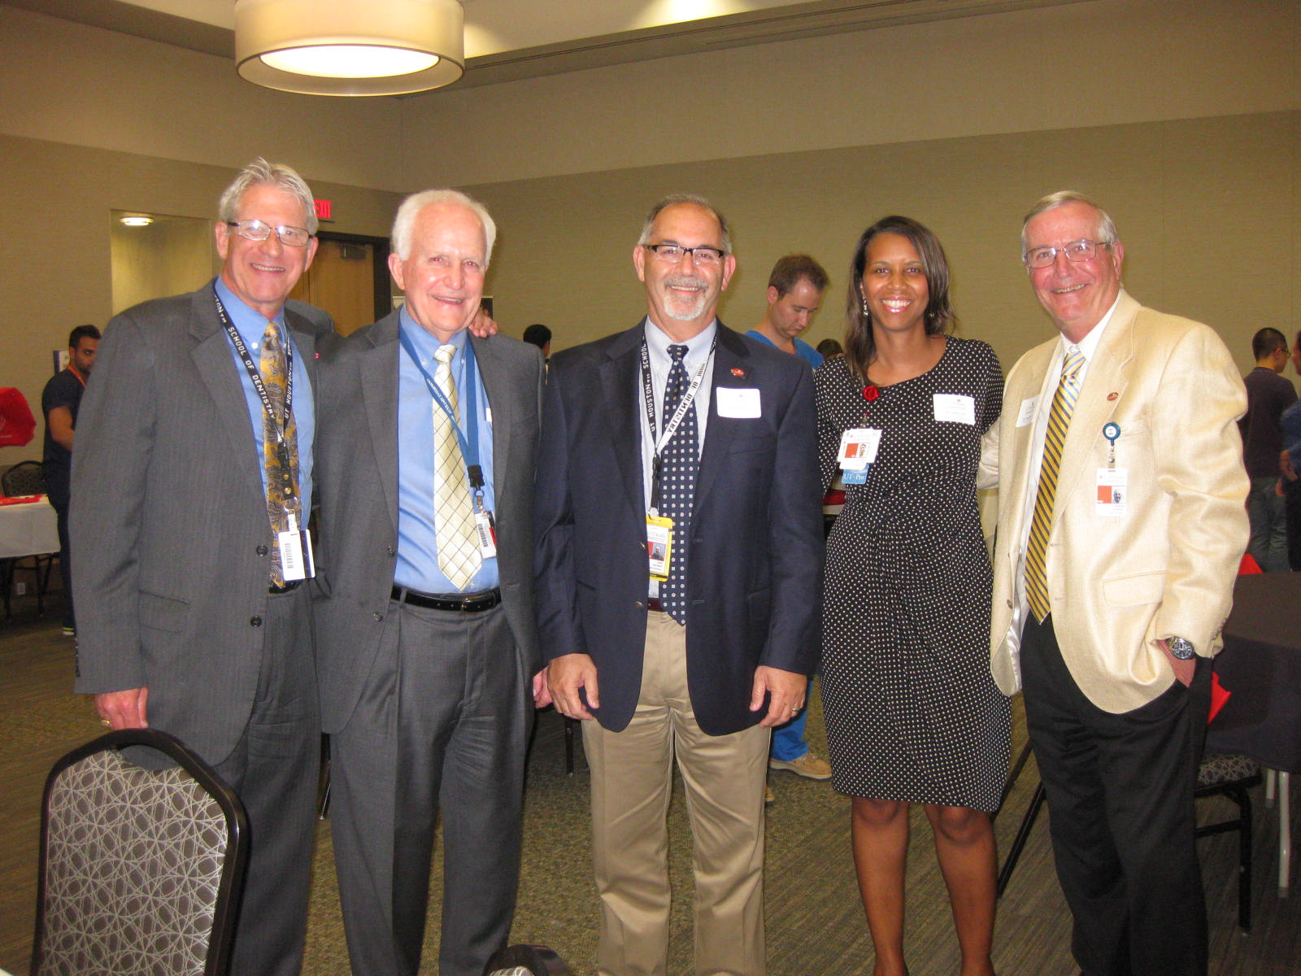
Left to Right: Dr. Phil Pierpont, Mr. Charlie Figari, Dr. John Valenza, Dr. LaTanya Love and Dr. George Stancel. Executive leadership enjoying Salutation!!

Slide 8
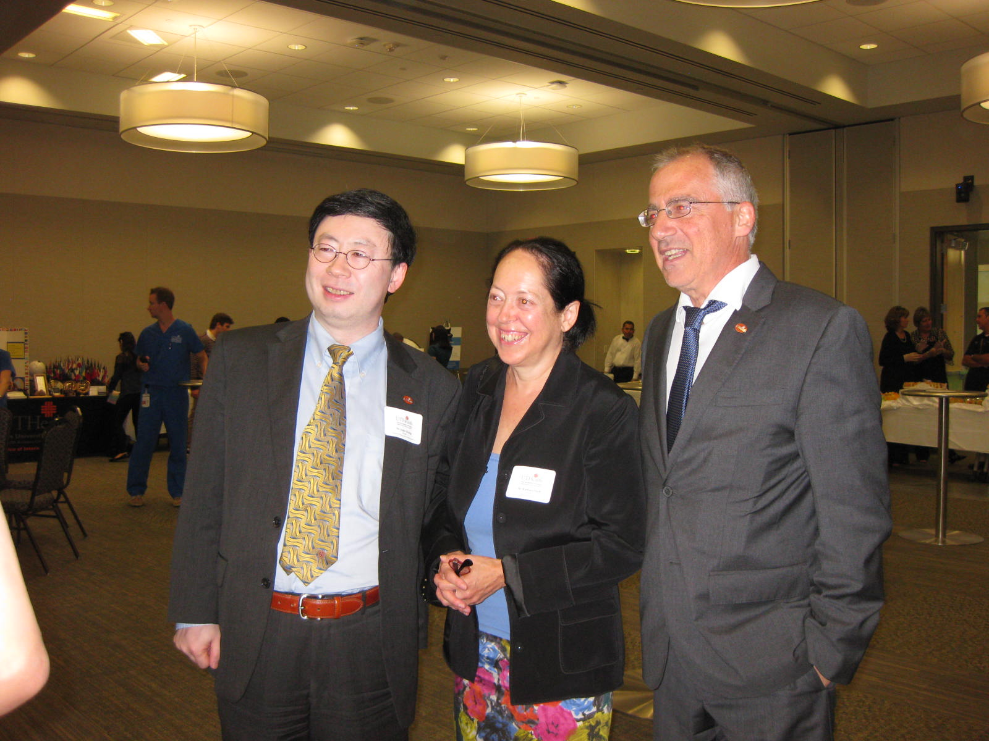
Dr. Jiajie Zhang, with Drs. Stoll and Colasurdo.

Slide 9
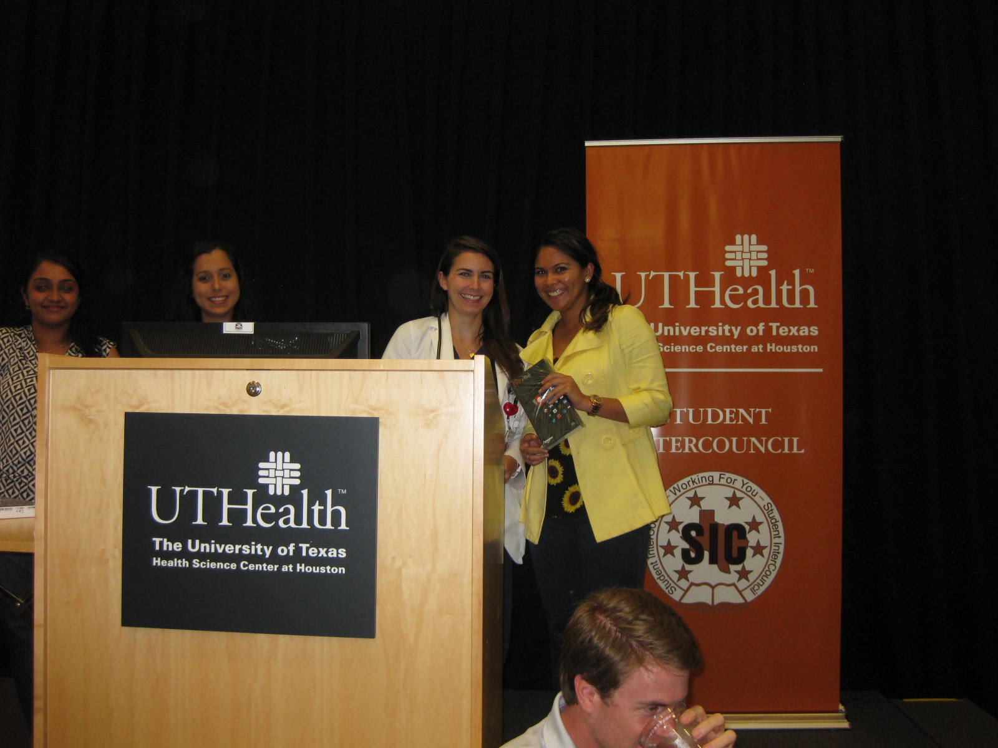
Fire HD Tablet Winner!

Slide 10
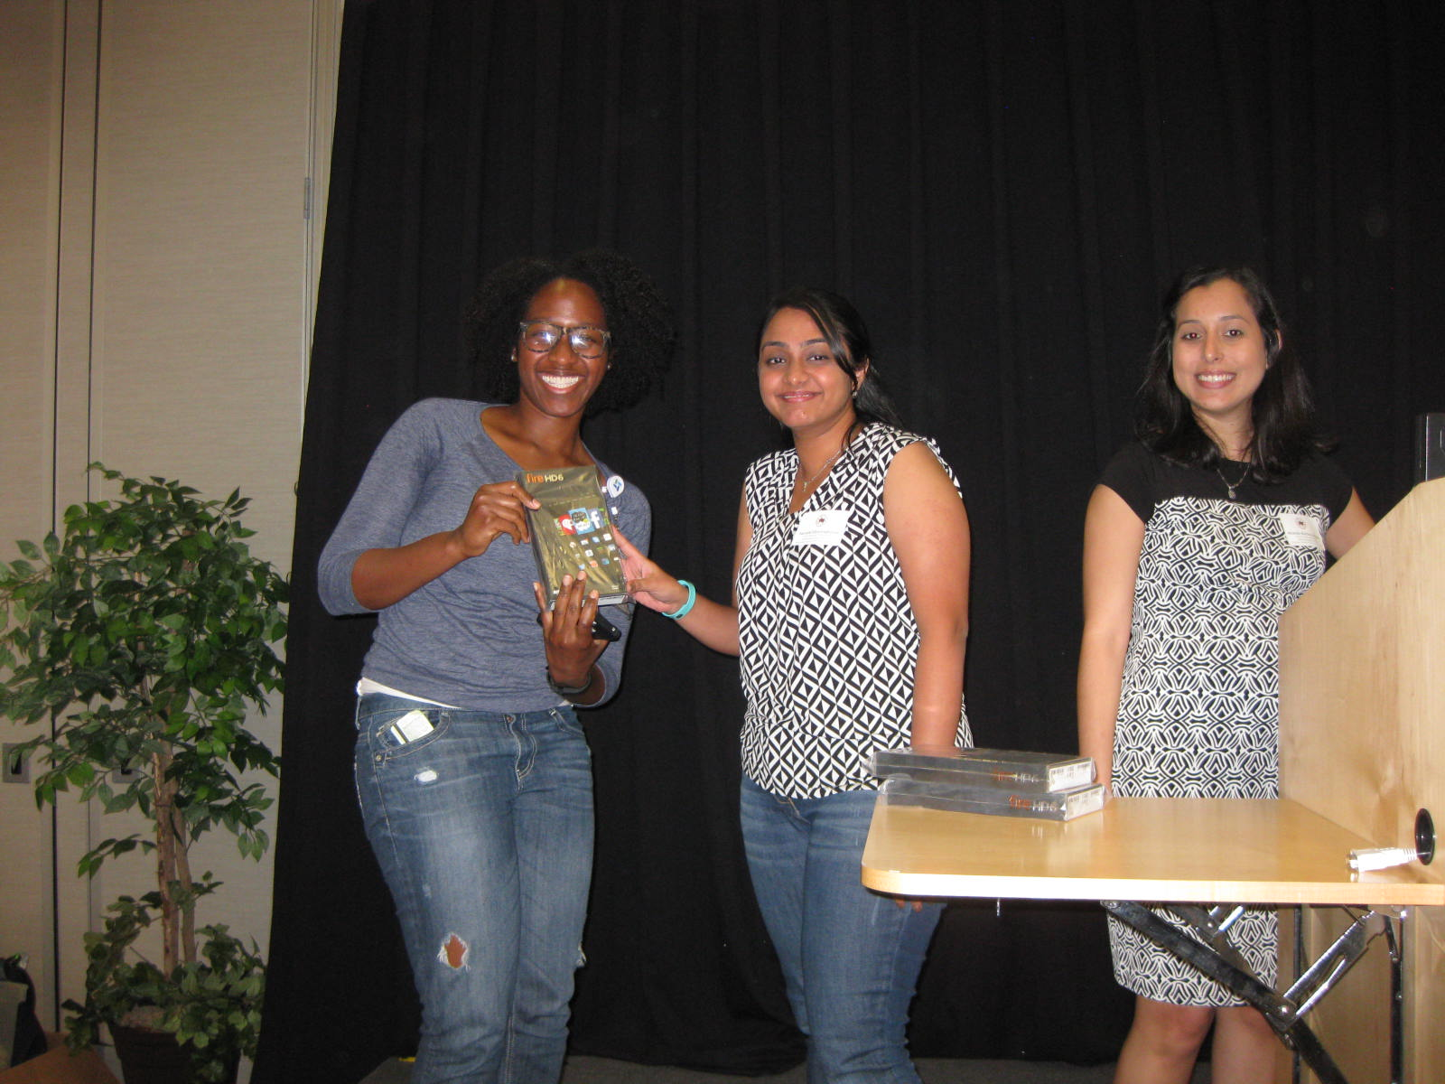
Fire HD Tablet Winner!

Slide 11
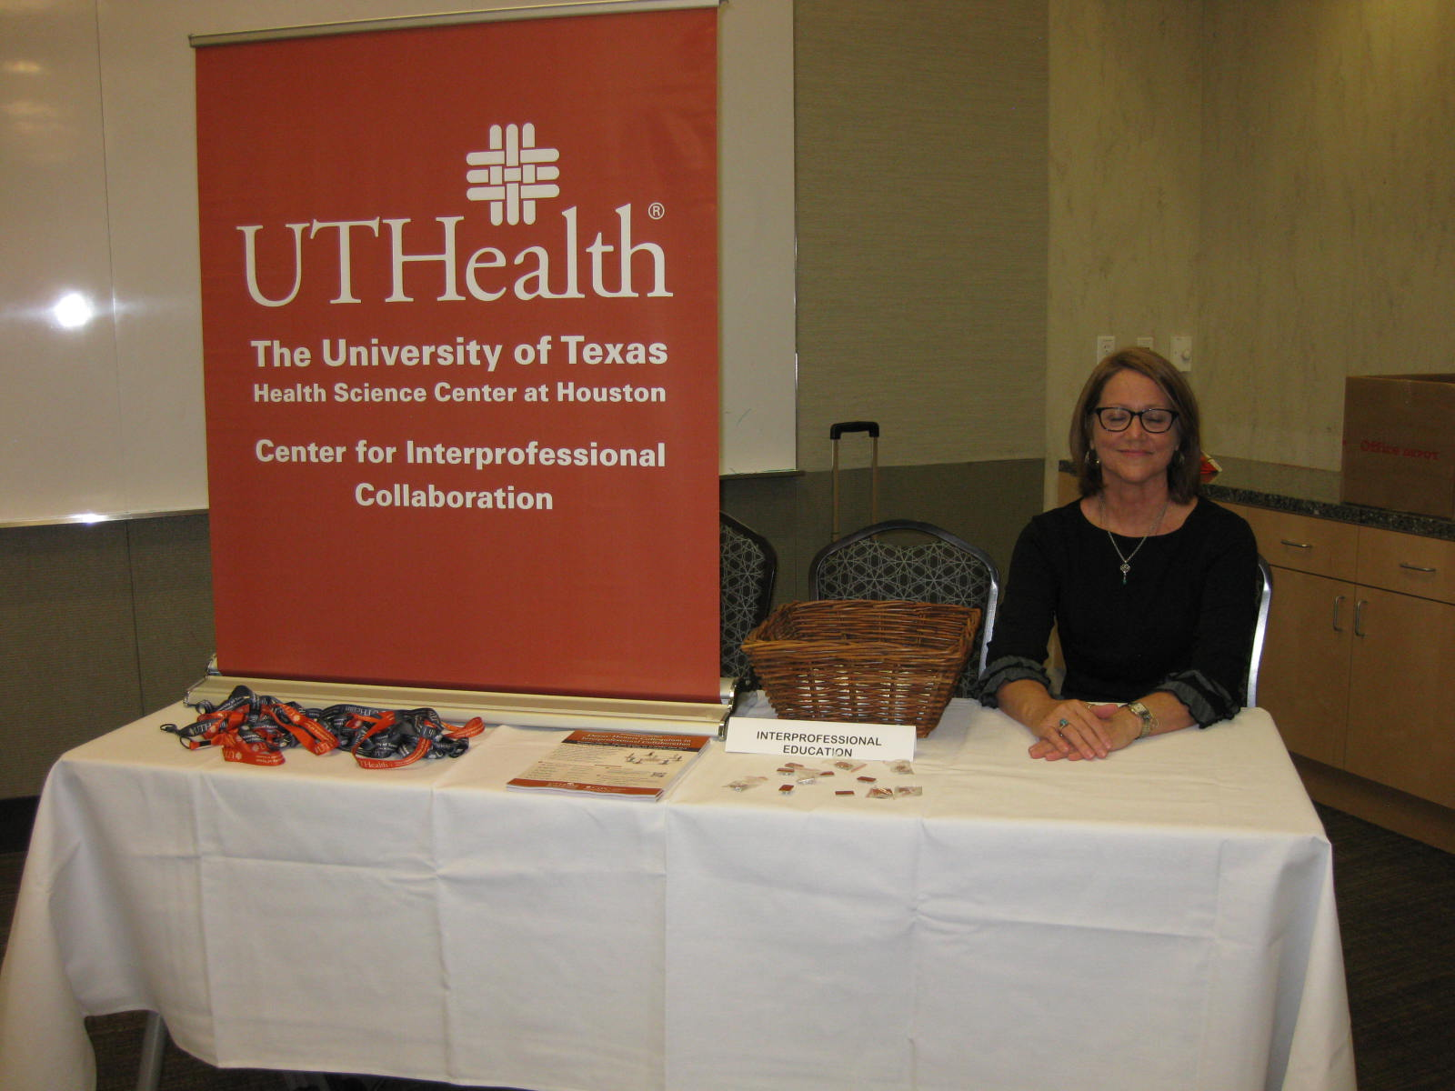

Slide 12
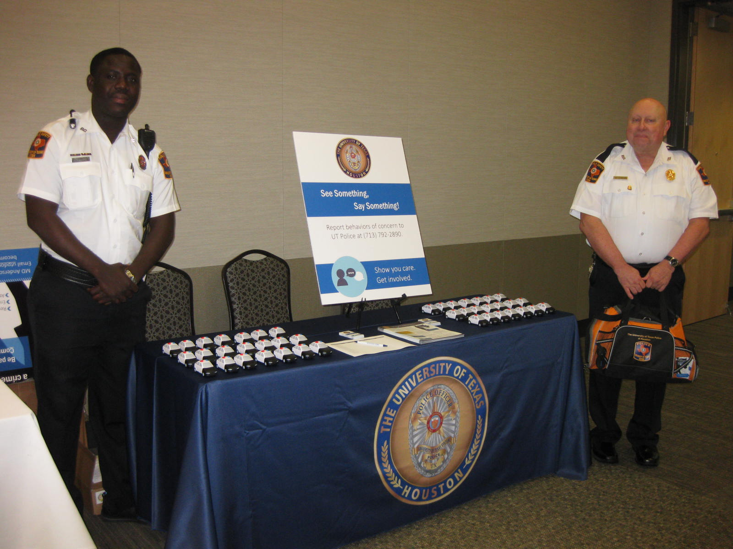

Slide 13
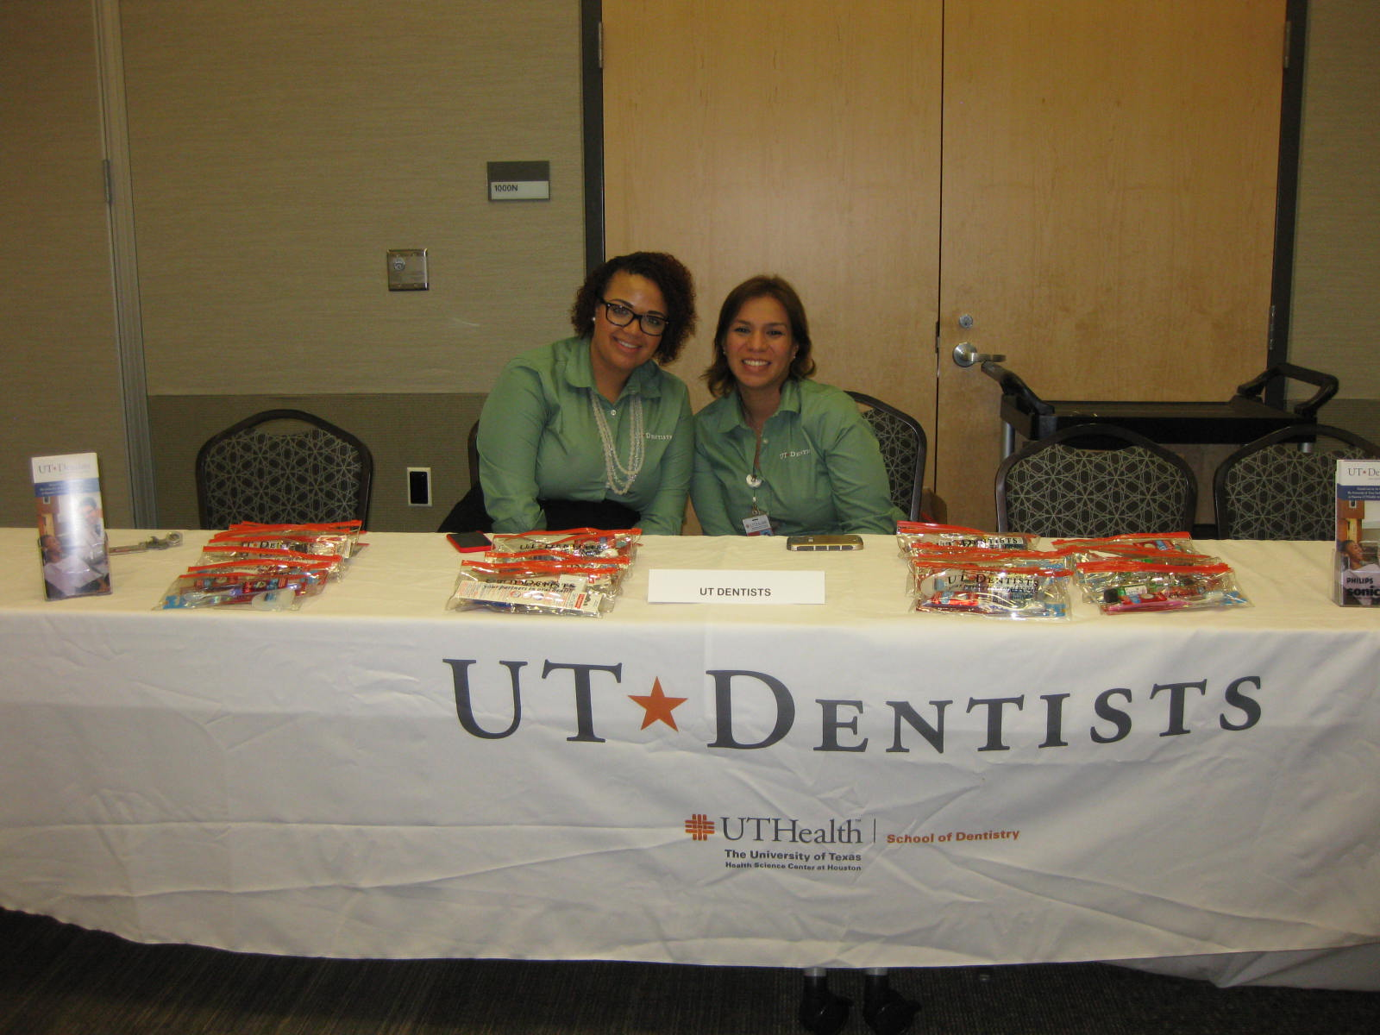

Slide 14
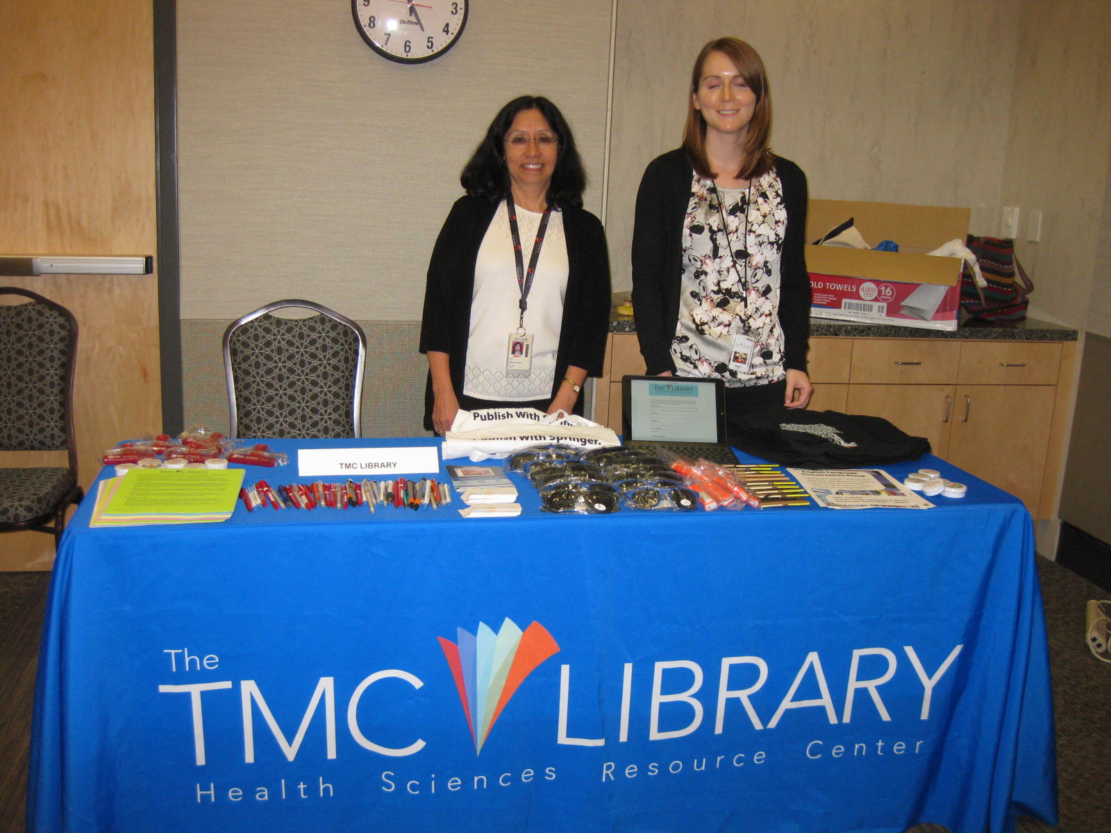

Slide 15
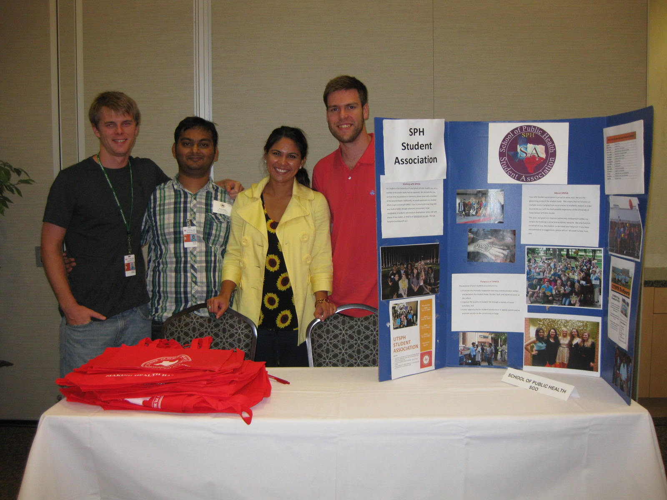

Slide 16
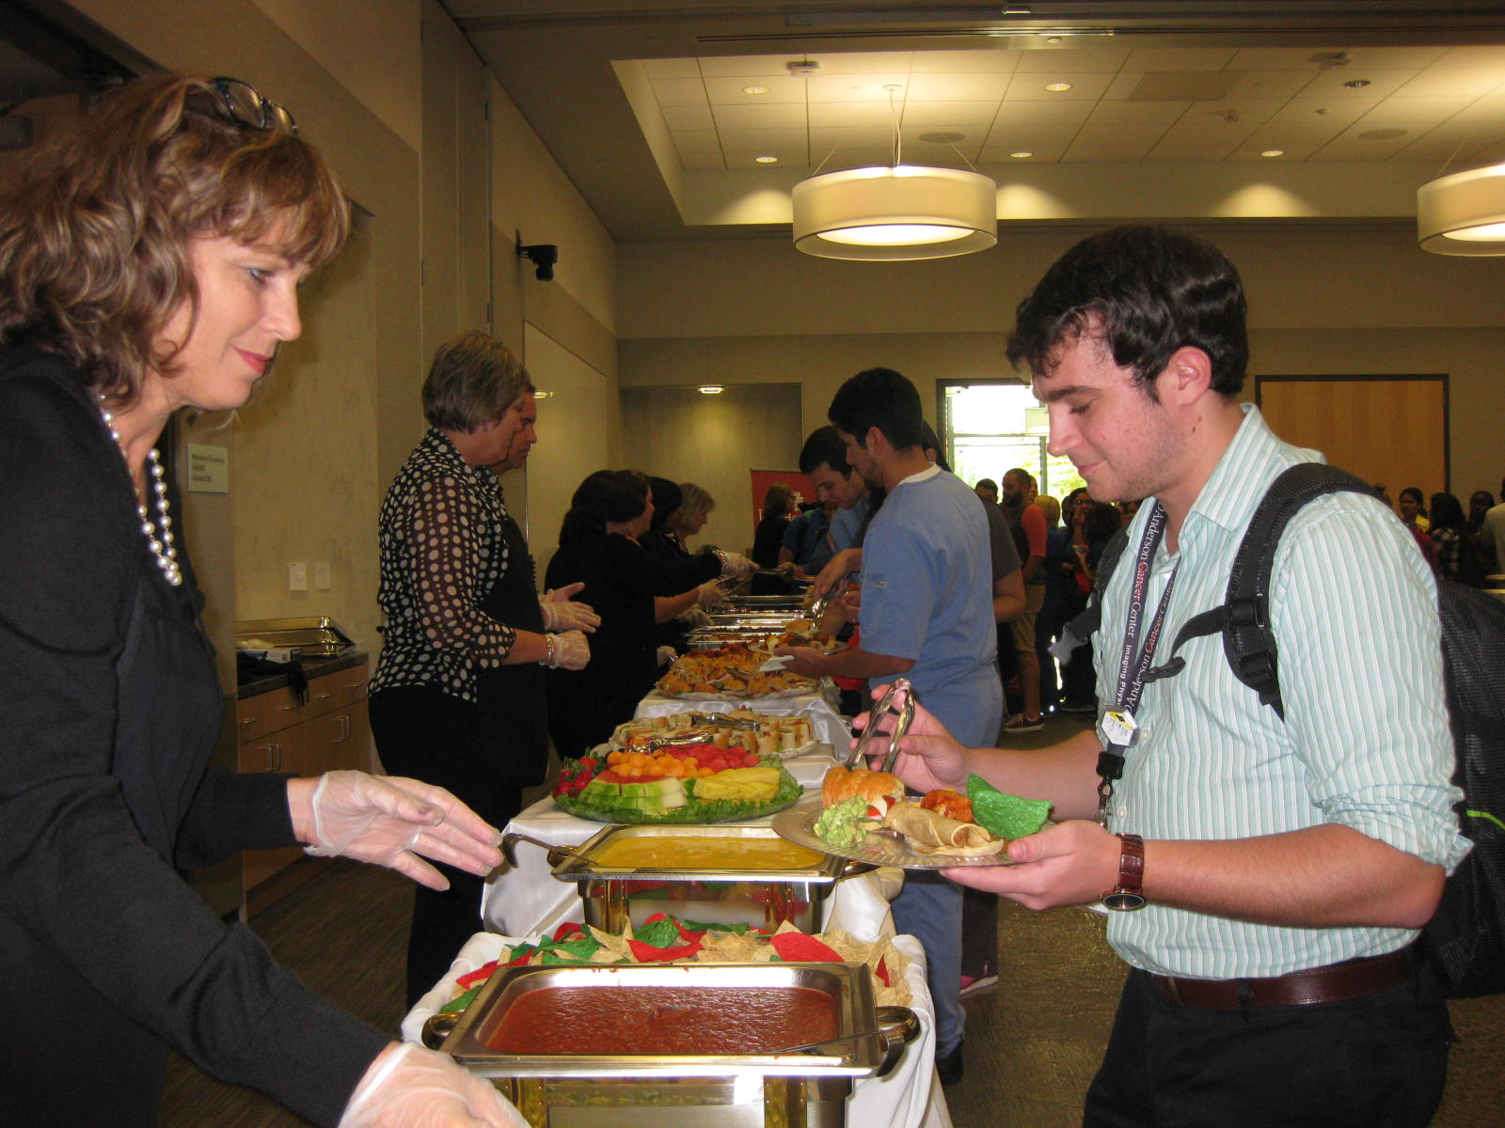

Slide 17
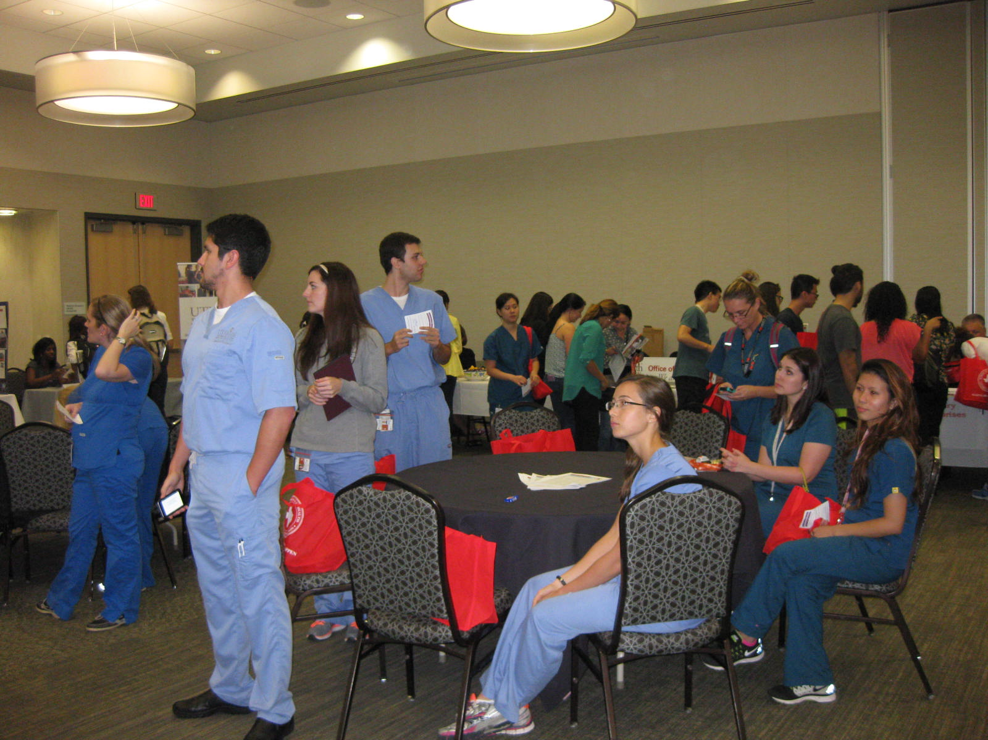

Slide 18
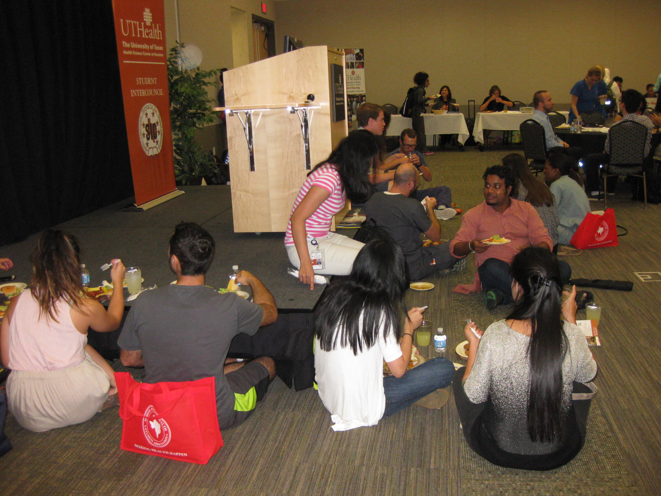

Slide 19
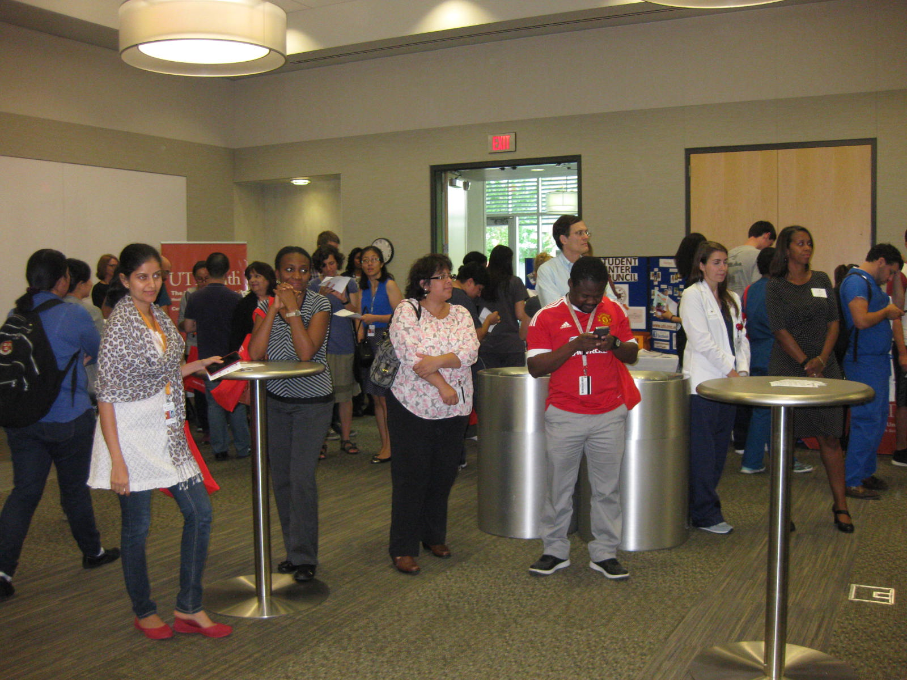

Slide 20
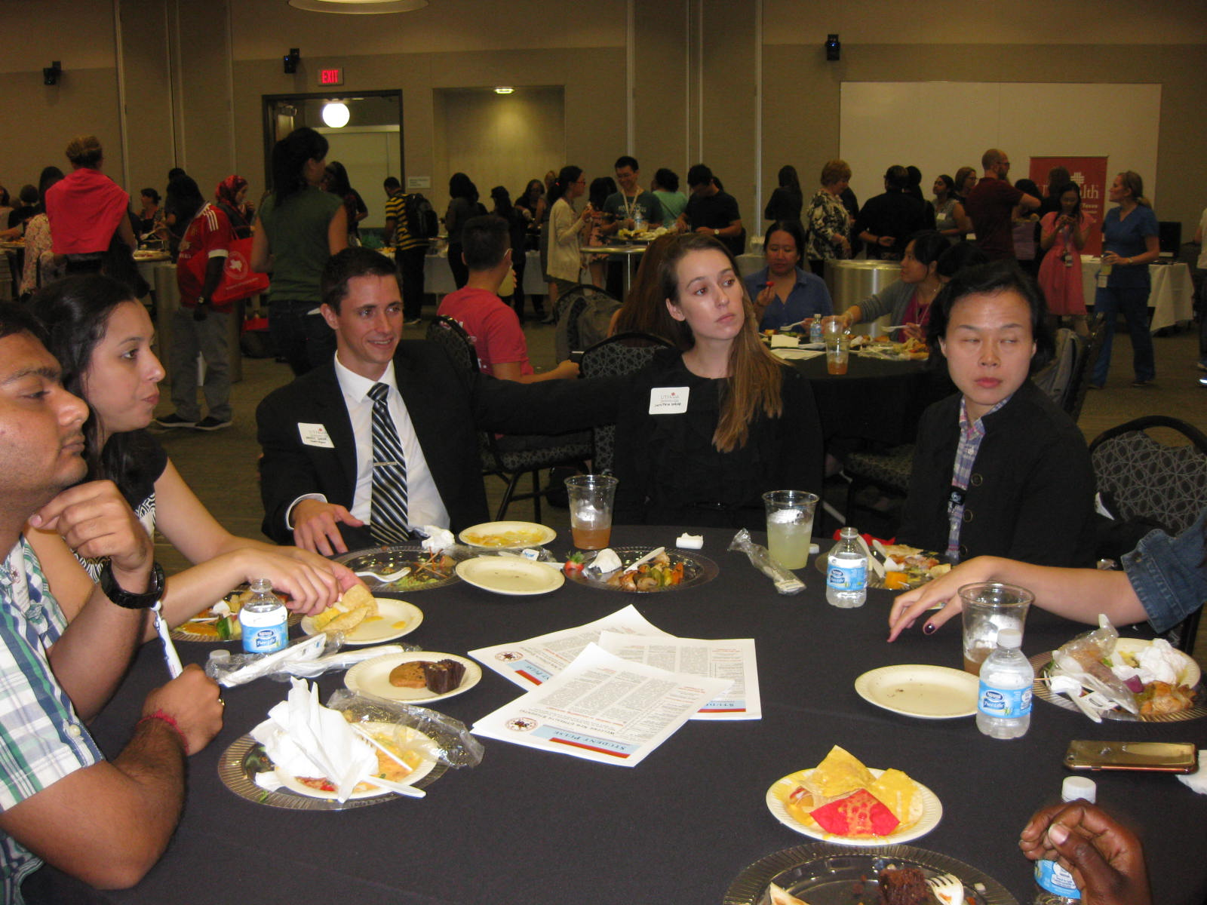

Slide 21
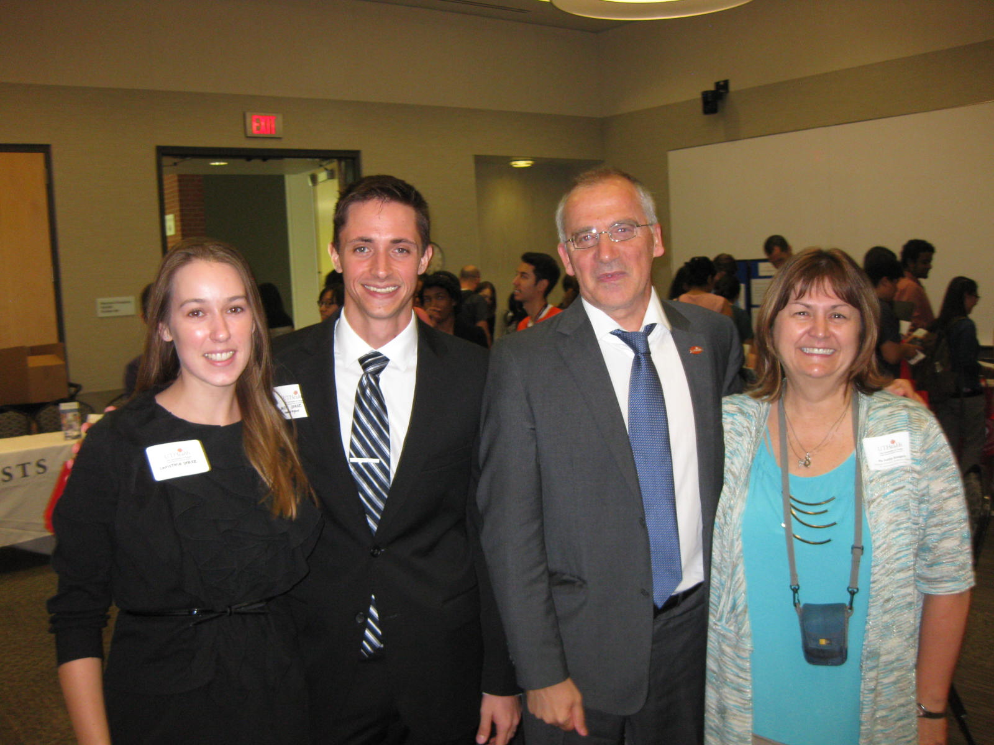
Left to Right: Christine Drake and Student Regent Justin Drake, Dr. Giuseppe Colasurdo, UTHealth President, and Kathy Rodgers, SIC Administrative Advisor.
SEE YOU NEXT YEAR!!!

