Slide 1

Instructions for Wipe Testing for Radioactive Material Contamination
Radiation Safety Program
Environmental Health & Safety
713-500-5840

Slide 2
Outline of Instructions
Purpose of Wipe Tests
UTHealth Wipe Test Requirements
Wipe Test Materials
Appropriate Lab Attire
UTHealth Radiation Safety Forms
Instructions for Wipe Tests
How to Clean a Contaminated Area
Safety Resources on the Web
Summary

Slide 3
Purpose of Wipe Tests for Radioactive Material Contamination
To ensure that education, research, and health-care related activities take place in conditions that are optimally safe and healthy for students, faculty, staff, visitors, surrounding community, and general public.

Slide 4
UTHealth Wipe Test Requirements
Any Room Authorized to Work with Radioactive Materials Must at Least
  Document monthly wipes where used, stored and selected “clean” areas
  If storage only, monthly wipe test of storage location
  If no use AND no storage, monthly statement indicating “no radioactive material used or stored for XXX month”
Additional requirements may occur for researchers working with greater than 5 mCi
  Urine bioassay and more frequent surveys

Slide 5
Contamination Survey
For the protection of the researchers and all workers in the lab, a contamination survey should be performed at the end of each experiment or project.
Proper documentation requires written survey results at least monthly
Can be performed with a Geiger-Mueller detector
Simple check to make sure there is no contamination in the lab that may have resulted from the radiation work

Slide 6

Safety Resources on the Web
www.uth.edu
safety

Slide 7
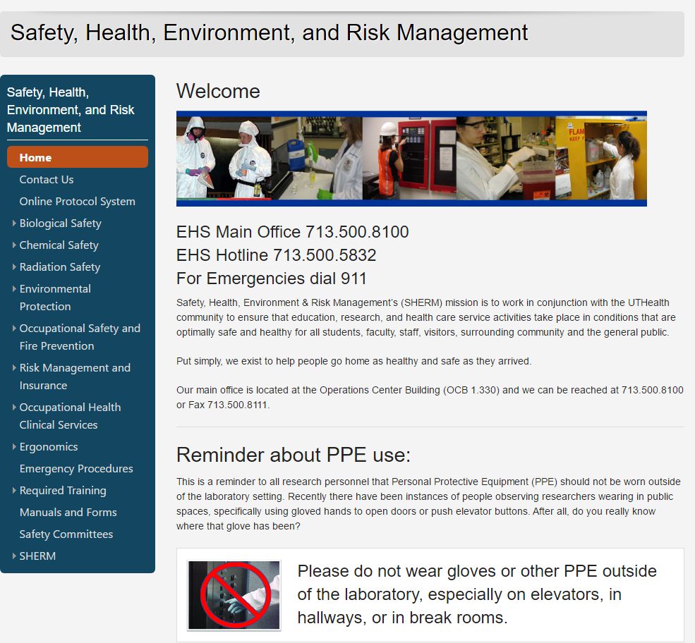
Radiation Safety

Slide 8
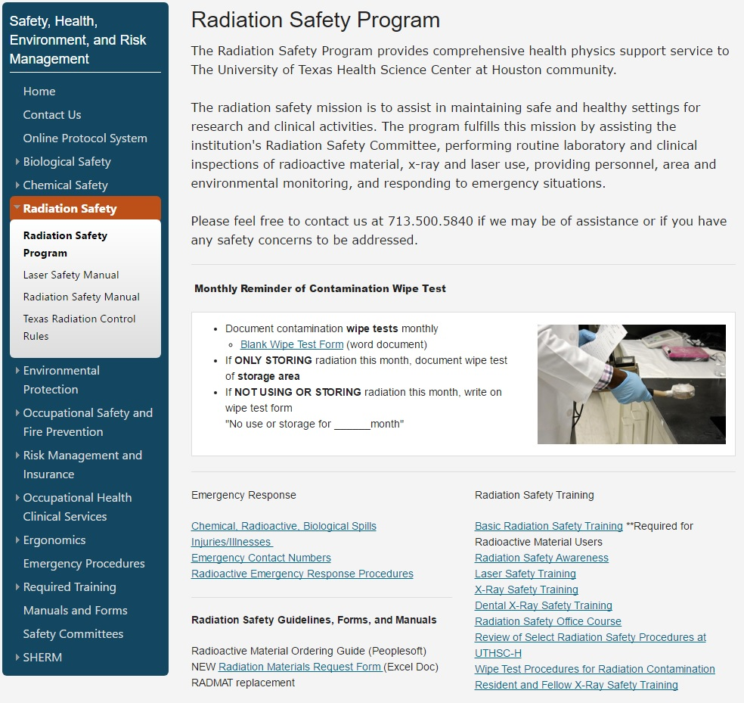

Slide 9
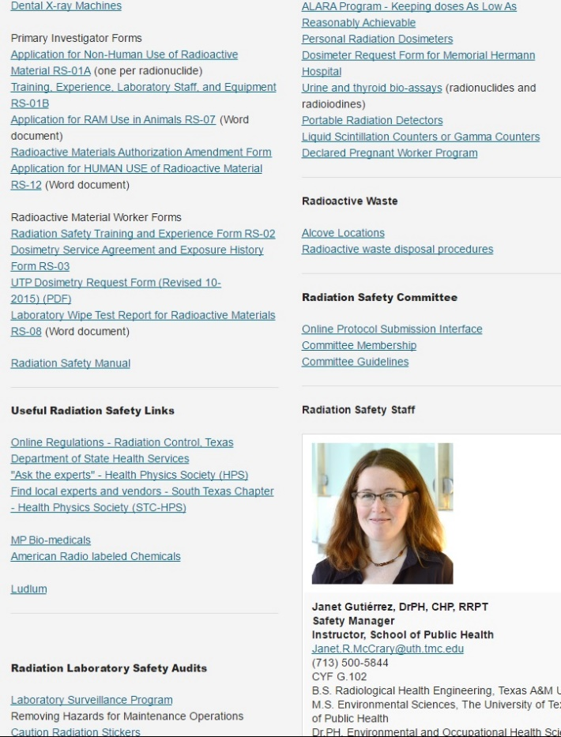
RS-08

Slide 10
Radiation Safety Requirements
Upon Receipt of Radioactive Material
Documented monthly lab wipe tests
  Wear proper attire
    Lab coat
    Eye protection
    Gloves
  Gather equipment
    Cotton swab, filter paper, or paper towel
    Vial or Envelope

Slide 11
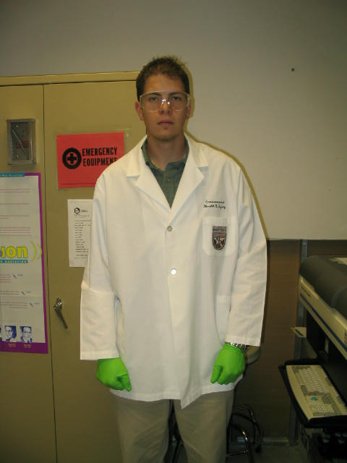
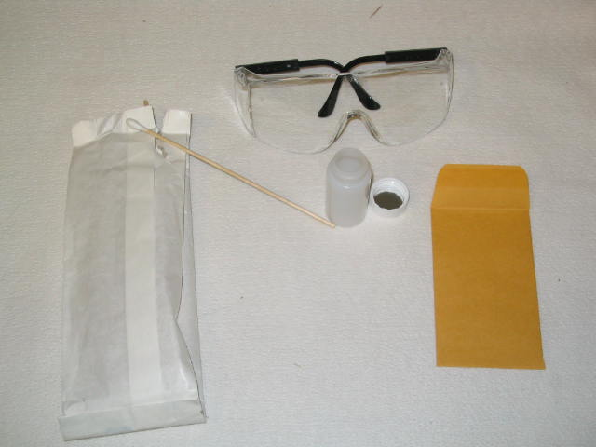
Attire & Equipment

Slide 12
Wipe Test Procedure
Use cotton swab to take several samples from different areas within the lab
At least one wipe in storage area
  If no use or storage in month, document as “no use or storage in XXX month”
Place samples in separate vial or envelope
Label each vial or envelope noting the location of the sample
Fill out “Laboratory Wipe Test Report”

Slide 13
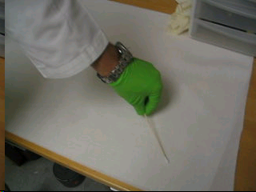
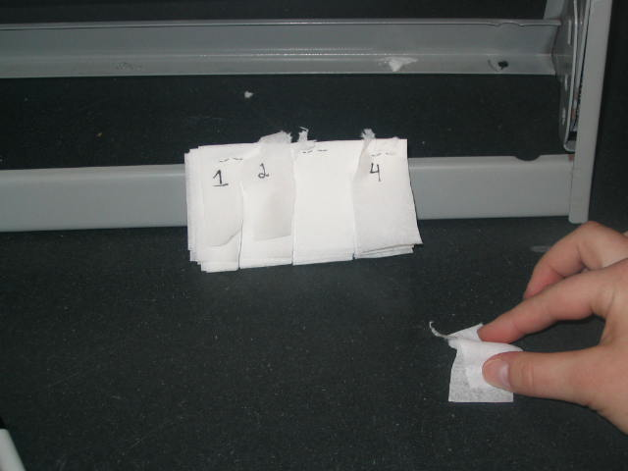
Collecting the Sample
Take samples using a “S” motion while rotating the cotton swab. Also shown, collecting a sample using a chem wipe.

Slide 14
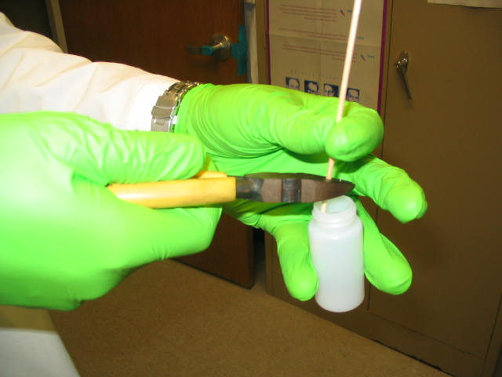
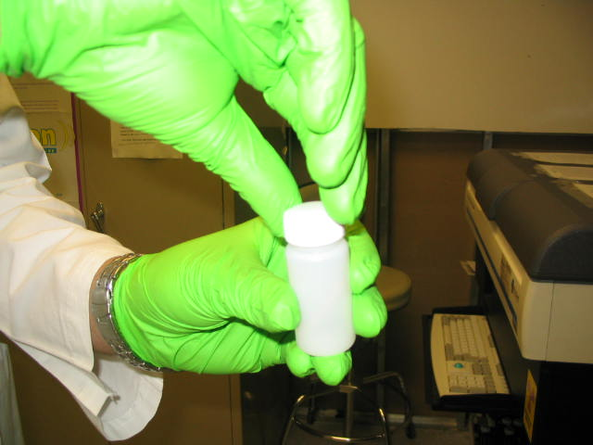
Collecting the Sample
Cut stick of cotton swab down to fit inside vial and close vial with lid.

Slide 15
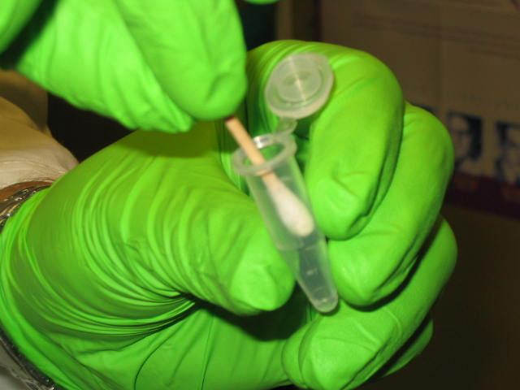
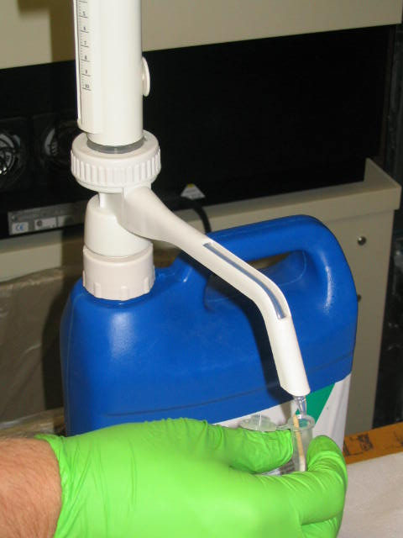
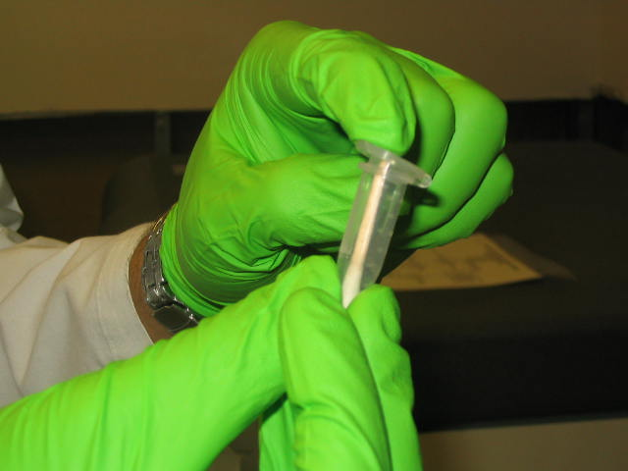
Preparing the Samples
Samples are placed individually in separate eppendorf tubes and 1 mL of cocktail or enough cocktail to cover the sample is added
A blank Eppendorf tube is prepared in the same manner that will serve as the background sample
Take out cotton swab and place in tube
Fill tube with approximately 1 ml of cocktail and close tube

Slide 16
Loading the Samples
Place tubes into vial holders
Insert tubes into LSC racks
Load racks into the Liquid Scintillation Counter (LSC) and flag the samples for counting by moving tab.
Example for loading the LSC:
  Slide the tab located on the rack to the position where the color is not showing.
    This tells the LSC that the sample has not been read.
  When the tab is in the opposite position it signals to the user and LSC that the sample has been read.

Slide 17
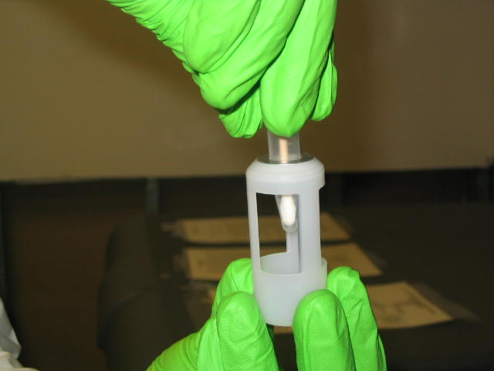
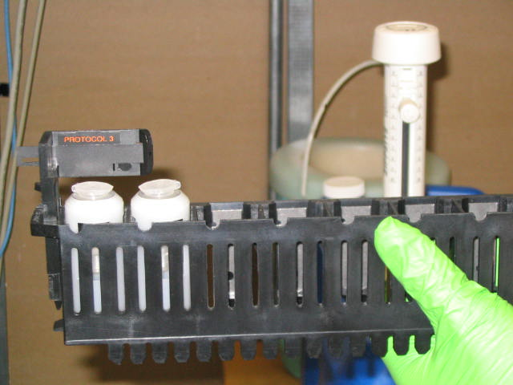
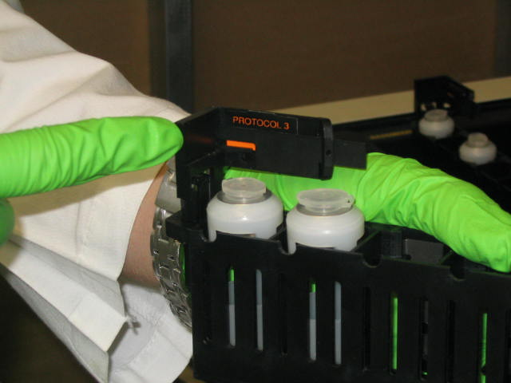
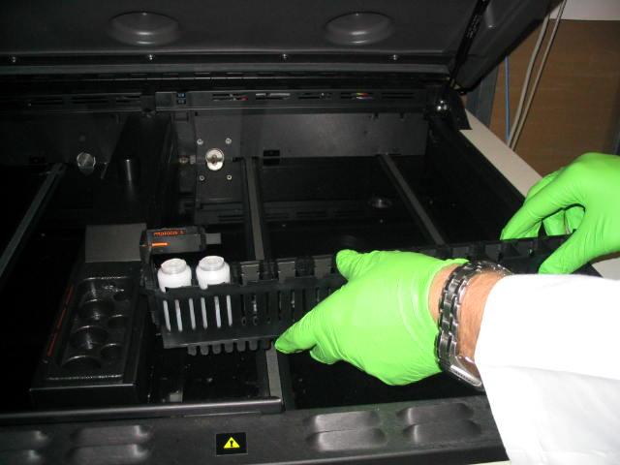
Loading the Samples
Place closed tube into vial holder
Tab position indicates vials to be read.
Tab position indicates vials will not be read.
Load rack into LSC to run wipe test

Slide 18
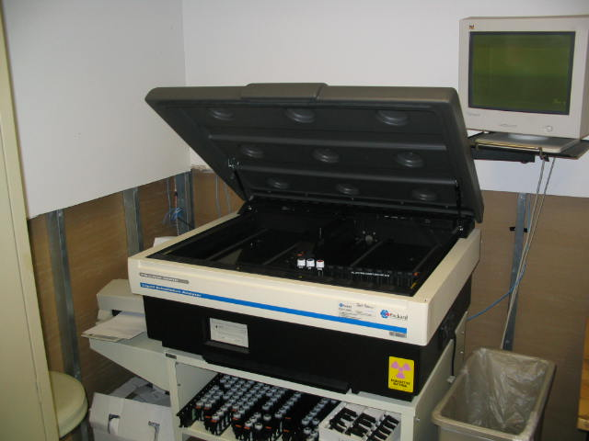
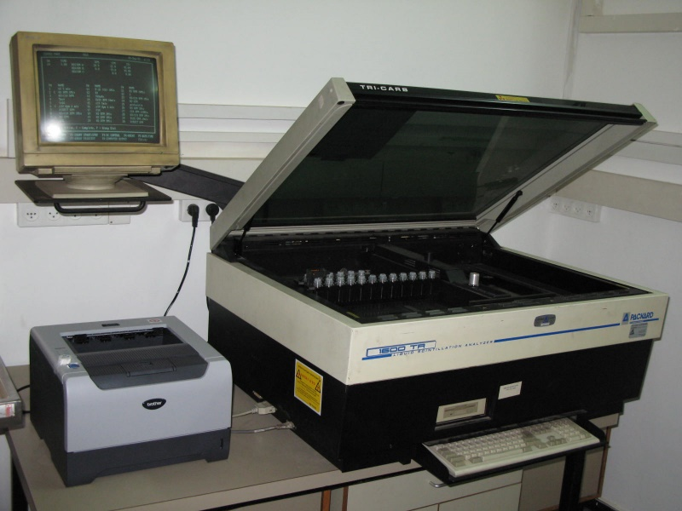
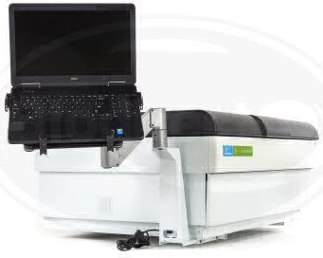
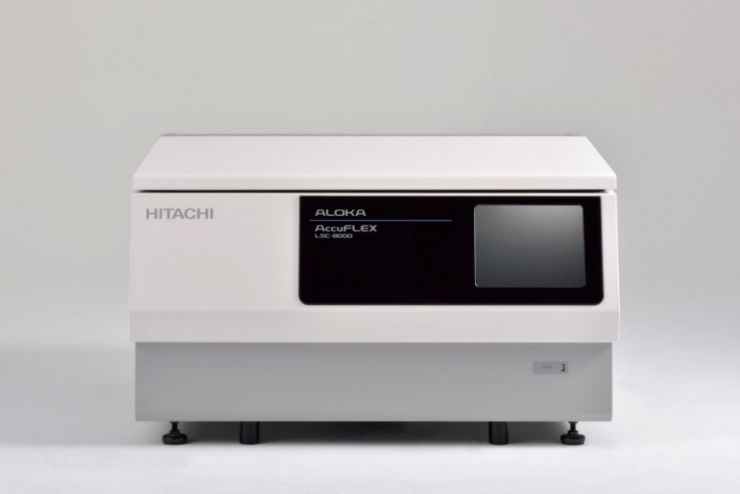
Liquid Scintillation Counters (LSCs)

Slide 19
Filling out the Report
Fill out all necessary information
  Authorized user
  Date
  Building and Room number
  Wipe tested by
Draw and label laboratory diagram in space provided

Slide 20
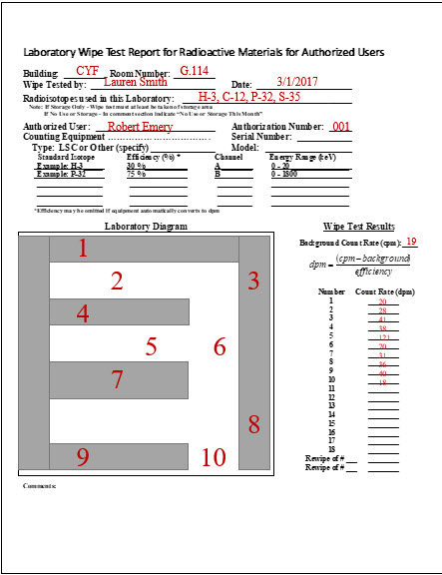
RS-08 form

Slide 21
How to know if there is contamination?
  Wipe test results show counts in excess of three times the background count.
  Contaminated area should be documented and cleaned, then re-wiped to verify area now clean.
  Channels on the LSC should be set to maximum beta energy for isotope(s) of interest
    If upon running a wipe test a channel produces high value counts, then based upon that channel one can determine what isotope is the contaminating factor

Slide 22
Quick Contamination Calculation
A rule of thumb for determining if the area is contaminated is if the sample CPM is greater than three (3) times that of the background
Contaminated area > (3)*(Background)

Slide 23
If Area is Contaminated
Take proper precautions
IF MINOR Spill or Contaminated Area–
  Clean the affected area per proper lab cleanup procedures
IF MAJOR Spill or Contaminated Area-
  Secure the area, prevent re-entry
  Contact Radiation Safety for Assistance
    713-500-5840 During Business Hours
    713-500-4357 After Hours (500-HELP) UT Police

Slide 24
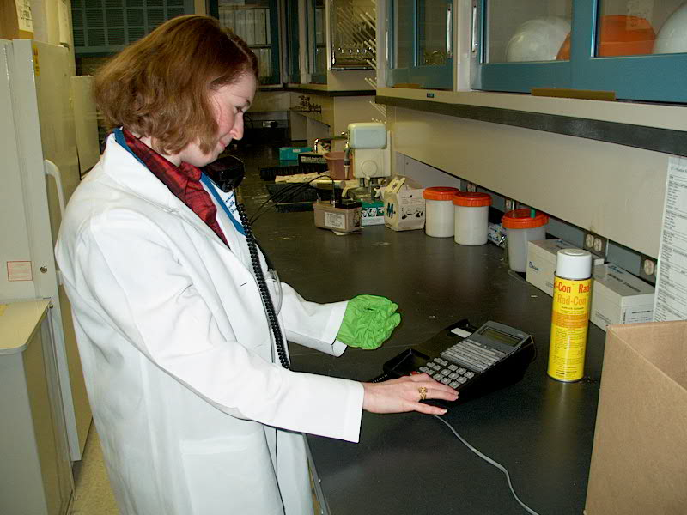
How to Clean Up Contamination
Ensure that spill is contained
  Limit traffic where event occurred.
  Prevent runoff (from table to floor or spreading on table).
  Inform coworkers and lab manager.
  Call Radiation Safety! (713) 500-5840

Slide 25
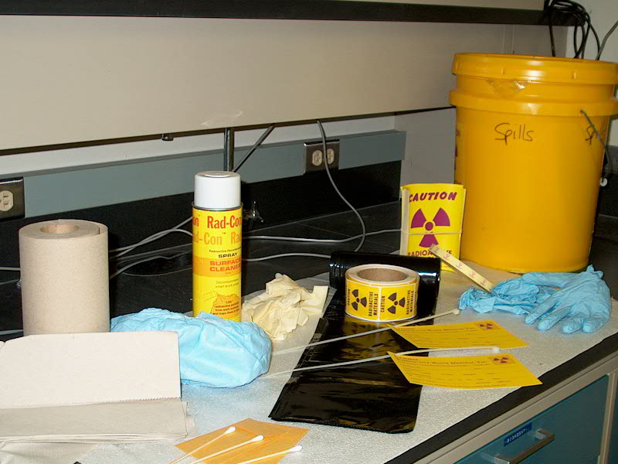
How to Clean Up Contamination
Obtain necessary supplies for cleanup
  Paper towels or diapers
  RADCON or Scrubbing Bubbles (DOW)
  Opaque plastic bags for waste.
  Labels
  Gloves

Slide 26
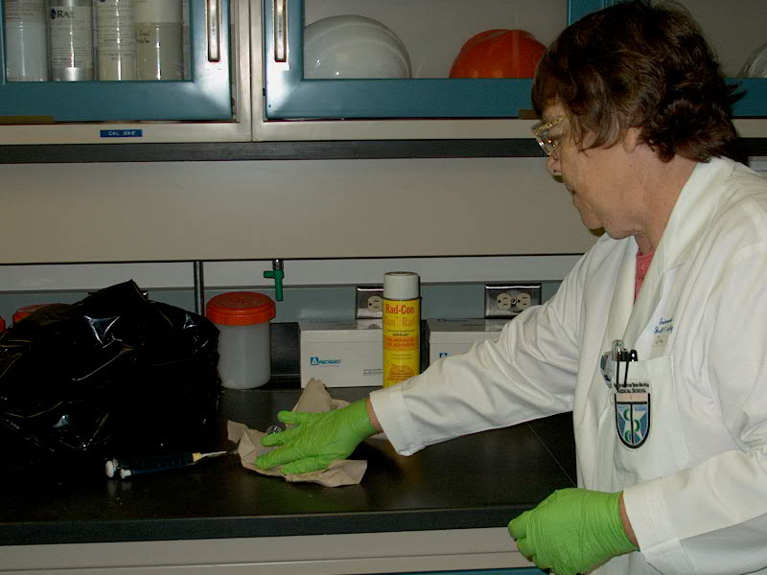
How to Clean Up Contamination
Ensure that contamination is contained

Slide 27
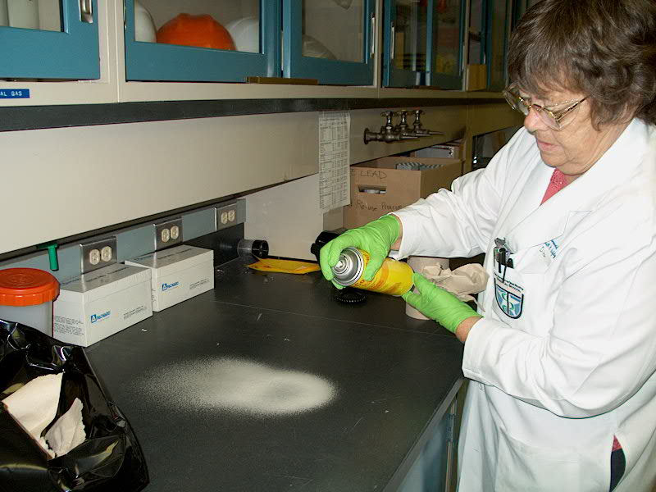
How to Clean Up Contamination
Spray area with RADCON or Scrubbing Bubbles (DOW) to lift contamination from the surface

Slide 28
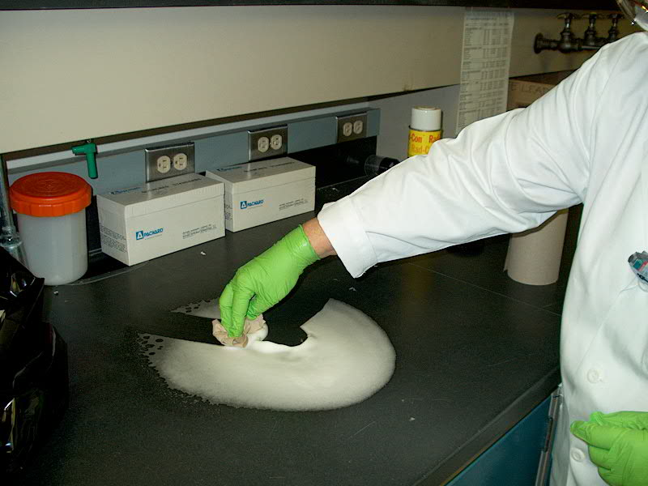
How to Clean Up a Contamination
Wipe from the outside in so not to spread the contamination

Slide 29
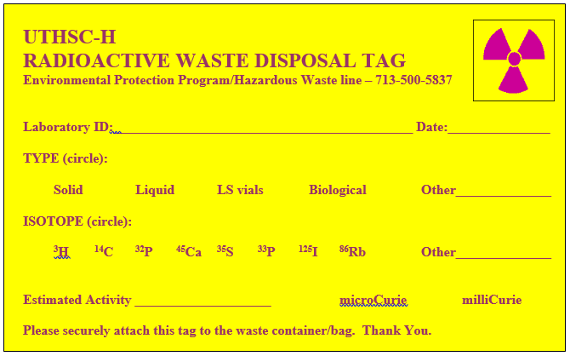
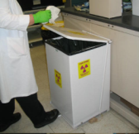
How to Clean Up a Contamination
Dispose waste in a proper waste container or in a black bag with
proper labeling

Slide 30
Review
Documented Monthly Wipe Tests for Radioactive Material Contamination are Required
A Radioactive Spill or Contaminated Area Should be Decontaminated (Cleaned) and Wipe Tested Again
For Assistance, You can Contact Radiation Safety at 713-500-5840

